Slide 1
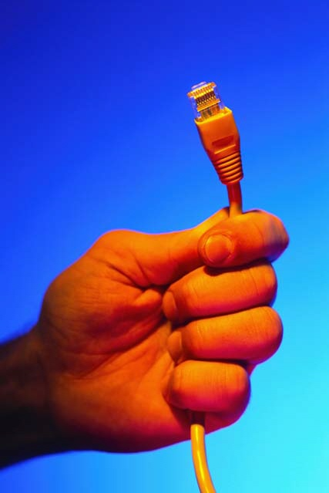
Physical Layer Propagation
Chapter 3
Panko’s Business Data Networks and Telecommunications, 5th edition
Copyright 2005 Prentice-Hall

Slide 2
Orientation
Chapter 2
  Data link, internet, transport, and application layers
  Characterized by message exchanges
Chapter 3
  Physical layer
  No messages—bits are sent individually
  Media, plugs, propagation effects

Slide 3


Figure 3-1: Signal and Propagation
Transmitted
Signal
Received Signal
(Attenuated &
Distorted)
Propagation
Transmission Medium
Sender
Receiver
If propagation problems are too large, the receiver will not be able to read the received signal

Slide 4
Signaling

Slide 5

Figure 3-2: Binary Data
Binary Data
  Messages at the data link layer and higher layers are bit strings (strings of ones and zeros) representing information
  Some data are inherently binary
    For instance, 48-bit Ethernet addresses and 32-bit IP addresses are binary bit strings

Slide 6
Figure 3-2: Binary Data, Continued
Binary Arithmetic for Binary Numbers
(Counting Begins with 0, not 1)
0
1
2
3
4
5
6
7
8
0
1
10
11
100
101
110
111
1000

Slide 7
Figure 3-2: Binary Data , Continued
Binary Arithmetic for Binary Numbers
(Counting Begins with 0, not 1)
Basic Rules
1
0 0 1 1 +1
+0 +1 +0 +1 +1
=0 =1 =1 =10 =11

Slide 8
Figure 3-2: Binary Data , Continued
1000 8
+1 +1
=1001 =9
+1 +1
=1010 =10
+1 +1
=1011 =11
+1 +1
=1100 =12
Examples

Slide 9
Figure 3-2: Binary Data , Continued
Encoding Alternatives
(Number of Alternatives = 2^Number of Bits)
Number of Bits
In Field
1
2
3
4
8
16
…
Number of Alternatives
That Can be Encoded
2
4 (2^2)
8 (2^3)
16 (2^4)
256 (2 ^ 8)
65,536 (2^16)
…
Each added bit doubles the number of things that can be represented

Slide 10
Figure 3-2: Binary Data , Continued
Bits | Alternatives | Examples
1 | 2^1=2 | Male = 0, Female = 1
2 | 2^2=4 | Spring = 00, Summer = 01, Autumn = 10, Winter = 11
8 | 2^8=256 | Keyboard characters for U.S. keyboards. Space=00000000, etc. ASCII code actually uses 7 bits

Slide 11
Figure 3-3: On/Off Signaling
Clock
Cycle
Light
Source
Off=
0
On=
1
On=
1
Off=
0
On=
1
Off=
0
On=
1
Optical Fiber

Slide 12
Figure 3-4: Binary Signaling
15 Volts
Clock Cycle
0
0
0
3 Volts
This type of
signaling is used in
232 serial ports.
0 Volts
-3 Volts
1
1
-15 Volts

Slide 13
Figure 3-4: Binary Signaling: Resistance to Propagation Errors , Continued
15 Volts
0
Transmitted
Signal
(12 Volts)
3 Volts
Received
Signal
(6 volts)
0 Volts
-3 Volts
1
Despite a 50% drop in voltage,
the receiver will still know
that the signal is a zero
-15 Volts

Slide 14
Figure 3-4: Binary Signaling , Continued
There are two states (in this case, voltage levels)
  One (high) represents a 0
  The other (low) represents a 1
State is held constant within each clock cycle.
  Can jump abruptly at the end of each cycle
  Or can stay the same
One bit is sent per clock cycle

Slide 15
Figure 3-5: Digital Signaling
Clock Cycle
11
11
10
10
01
01
01
00
00
Client PC
Server
Digital signaling has a few possible states per clock cycle
This allows it to send multiple bits per clock cycle
This increases the bit transmission rate

Slide 16
Figure 3-5: Digital Signaling , Continued
In digital transmission, there are few states (in this case, four)
Binary transmission, in which there are two states, is a special case of digital transmission
Digital signaling has less resistance to propagation errors because there are more states, so the difference between states is smaller

Slide 17

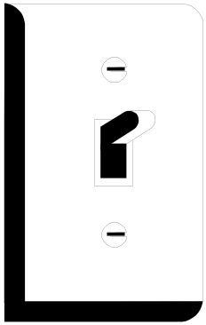

Quiz
Which is Binary? Which is Digital?
On/Off
Switch
Number
Of
Fingers
Calendar
Day of the Week
Gender
Male or Female

Slide 18
Figure 3-5: Digital Signaling , Continued
Equation 3-1: Bit rate = Baud rate *
Bits sent per clock cycle
  If the clock cycle is 1/1000 of a second, the baud rate is 1,000 baud
  If the three bits are sent per clock cycle, the bit rate is 3,000 bps or 3 kbps

Slide 19
Figure 3-5: Digital Signaling , Continued
Equation 3-2: States = 2^Bits per clock cycle
  If three bits are to be sent per clock cycle, how many states are needed?
    States = 2^3 or 8.
    8 bits are needed to send 3 bits per clock cycle.
  How many bits per clock cycle can be sent with eight states?
    8 = 2^X
    X must be 3 (by trial and error)

Slide 20
Figure 3-5: Digital Signaling , Continued
Example:
  Suppose there are four states.
  With four states, two information bits can be sent per clock cycle (4=2^2)
  Suppose that the clock cycle is 1/10,000 second
  With a clock cycle of 1/10,000, baud rate is 10,000 baud (10 kbaud—not 10 kbauds).
  The bit rate will be 20 kbps (two bits/clock cycle times 10,000 clock cycles per second).

Slide 21
Bit Rate and Baud Rate
Baud Rate
  The number of clock cycles per second
  Only interesting to technologists
Bit Rate
  Number of bits transmitted per second
  This is the important thing to users

Slide 22
UTP Propagation
Unshielded Twisted Pair wiring
Dominates on access lines from computers to workgroup switches

Slide 23
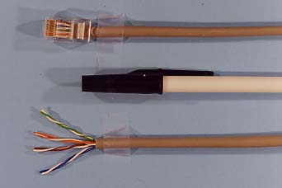
Figure 3-6: Unshielded Twisted-Pair (UTP) Cord with RJ-45 Connector, Pen, and UTP Cord With 4 Pairs Displayed
UTP Cord
With
RJ-45
Connector
Industry Standard Pen
4 Pairs
Separated
(8 Wires)

Slide 24
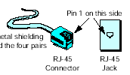
Figure 3-7: 4-Pair Unshielded Twisted-Pair Cable with RJ-45 Connector
Four pairs (each pair is twisted) are enclosed in a jacket.
The cord terminates in an 8-pin RJ-45 connector, which plus into
an RJ-45 jack in the NIC, hub, or switch.
Pin 1 on this side
No metal shielding
around the four pairs
RJ-45
Connector
RJ-45
Jack

Slide 25
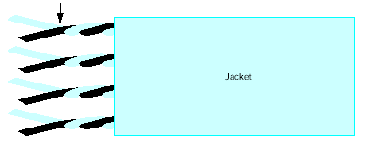
Figure 3-7: 4-Pair Unshielded Twisted-Pair Cable with RJ-45 Connector , Continued
8 Wires organized as 4 twisted pairs
Jacket

Slide 26
Figure 3-8: Noise and Attenuation
Power
Signal
Noise Spike
Noise Floor
(Average Noise
Level)
Noise
Distance

Slide 27
Figure 3-8: Noise and Attenuation , Continued
Power
Signal
Noise Spike
Signal-
to-Noise
Ratio (SNR)
Noise Floor
Noise
Distance
As a signal propagates, it attenuates, falling ever closer to the noise floor.
So noise errors increase with propagation distance, even if the average noise energy is constant.

Slide 28
Figure 3.9: Decibels
The decibel (dB) is a measure of attenuation
db = 10 log₁₀(P2/P1)
  P1 is the initial power, P2 is the final power
3 dB is a decline to half of a signal’s original power
  1/2 = 3 dB (P2 = P1/2)
  1/4 = 6 db
  1/8 = 9 dB
  …

Slide 29
Figure 3.9: Decibels , Continued
10 dB is a decline to one tenth of a signal’s original power
  1/10 = 10 dB (P2 = P1/10)
  1/100 = 100 db
  …
The decibel is a logarithmic scale
  Small increases in the number of decibels correspond to a large decrease in signal strength

Slide 30
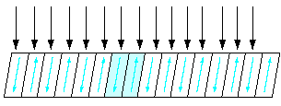

Figure 3-10: Electromagnetic Interference (EMI) and Twisting
Electromagnetic
Interference (EMI)
Twisted
Wire
Interference on the Two Halves of a Twist Cancels Out

Slide 31
Figure 3-11: Crosstalk Electromagnetic Interference (EMI) and Terminal Crosstalk Interference
Untwisted
at Ends
Signal
Crosstalk Interference
Terminal Crosstalk
Interference

Slide 32
Figure 3-11: Crosstalk Electromagnetic Interference (EMI) and Terminal Crosstalk Interference , Continued
EMI is any interference from outside.
Twisting each pair reduces EMI.
Signals in adjacent pairs interfere with one another (crosstalk interference).
Crosstalk interference is only large at the ends, where the wires are untwisted. This is terminal crosstalk interference.
Solution: untwist wires for connector no more than 1.25 cm (0.5 in).

Slide 33
EMI vs Cross-Talk Interference vs Terminal Cross-Talk Interference
EMI is any interference
  Signals in adjacent pairs interfere with one another (crosstalk interference). This is a specific type of EMI.
    Crosstalk interference is worst at the ends, where the wires are untwisted. This is terminal crosstalk interference—a specific type of crosstalk EMI.
EMI
Crosstalk Interference
Terminal Crosstalk
Interference

Slide 34
UTP Limitations
Limit cords to 100 meters
  Limits noise and attenuation problems to an acceptable level
Do not untwist wires more than 1.25 cm (a half inch) when placing them in RJ-45 connectors
  Limits terminal crosstalk interference to an acceptable level

Slide 35
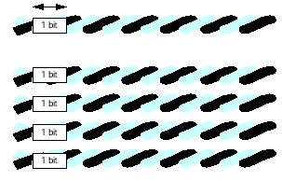
Figure 3-12: Serial Versus Parallel Transmission
One Clock Cycle
Serial
Transmission
(1 bit per clock cycle)
1 bit
Parallel
Transmission
(1 bit per clock cycle
per wire pair)
4 bits per clock cycle
on 4 pairs
1 bit
1 bit
1 bit
1 bit

Slide 36
Optical Fiber Transmission

Slide 37
Figure 3-13: Optical Fiber Cord
Cladding
125
micron
diameter
Light Source
(LED or
Laser)
Core
8.3, 50
or 62.5
Micron
diameter
Reflection at Core/Cladding Boundary
Light
Ray

Slide 38
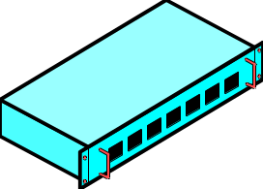
Figure 3-14: UTP in Access Lines and Optical Fiber in Trunk Lines
Core and
Workgroup
Switches
Fiber Trunk
Fiber Trunk
Core
Core Switch
Fiber
Trunk
Fiber
Trunk
Core Switch
Core Switch
Fiber Trunk
Workgroup
Switch
UTP
Access
Line
UTP
Access
Line
UTP
Access
Line
UTP dominates access lines;
Fiber dominates trunk lines

Slide 39

Figure 3-15: Full-Duplex Optical Fiber Cord
SC, ST,
or other
connector
Fiber
Switch
Fiber
Router
A pair of fibers is needed for full-duplex (simultaneous
two-way) transmission.
Each carries a signal in only one direction.

Slide 40
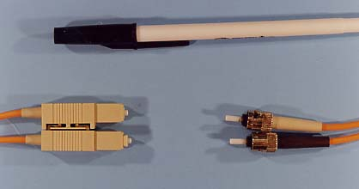
Figure 3-16: Pen and Full-Duplex Optical Fiber Cords with SC and ST Connectors
ST Connectors
(Push In and Snap)
ST Connectors
(Bayonet: Push In and Twist)

Slide 41
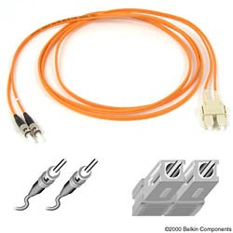
Figure 3-16: Pen and Full-Duplex Optical Fiber Cords with SC and ST Connectors , Continued
Two-fiber cords for full-duplex (two-way) transmission
ST
Connectors
(Popular)
SC
Connectors
(Recommended)

Slide 42
Figure 3-17: Wave Characteristics
Wavelength
Amplitude
Amplitude
Wavelength
1 Second
Frequency is the number of cycles per second.
In this case, there are two cycles in 1 second,
so frequency is two hertz (2 Hz).

Slide 43
Figure 3-18: Wavelength Division Multiplexing (WDM) in Optical Fiber
Optical Fiber Core
Light
Source 1
Signal 1
Signal 2
Light
Source 2
Multiple light sources transmit on different wavelengths.
Each light source carries a separate signal;
this gives more capacity per optical fiber cord.
Cheaper to add wavelengths (lambdas) than to lay new fiber cords

Slide 44
Figure 3-19: Optical Fiber Transmission
Attenuation
  Decreases with wavelength
    850 nm: better than 0.35 dB/km
    1300 nm: better than 0.15 dB/km
    1550 nm: Better than 0.05 dB/km
    In comparison, UTP attenuation is only better than 20 dB in 100 meters

Slide 45
Figure 3-19: Optical Fiber Transmission , Continued
Attenuation
  Light source prices increase with wavelength
    850 nm uses inexpensive LEDs
    1300 nm and 1550 nm use expensive lasers
  Must balance distance and cost

Slide 46
Figure 3-19: Optical Fiber Transmission , Continued
Modal Bandwidth
  Modal Dispersion
    Light rays only enter at a few angles
    These rays are called modes
    Different modes in the same light pulse travel different distances
    Over a long enough distance, the modes from sequential clock cycles tend to overlap, causing problems
    Also called temporal dispersion

Slide 47
Figure 3-20: Multimode and Single-Mode Optical Fiber
Light
Source
(LED or
Laser)
Core
Mode
Multimode Fiber
Light only travels in one of several allowed modes
Light travels faster at the edges to speed modes going the farthest
Multimode fiber must keep its distance short or limit modal distortion
Multimode fiber goes a few hundred meters and is inexpensive to lay
It is dominant in LANs

Slide 48
Figure 3-20: Multimode and Single-Mode Optical Fiber , Continued
Signals Travel Fastest
On Outside of Core
Graded Index of Refraction
(Decreasing from Center)
Cladding
Light
Source
Modes
Core
Graded Index Multimode Fiber

Slide 49
Figure 3-20: Multimode and Single-Mode Optical Fiber , Continued
Single Mode
Cladding
Light
Source
Core
Single Mode Fiber
Core is so thin that only one mode can propagate.
No modal dispersion, so can span long distances without distortion.
Expensive, so rarely used in LANs. Popular in WANs

Slide 50
Figure 3.17: Multimode and Single-Mode Fiber
Multimode
  Limited distance (a few hundred meters)
  Inexpensive to install
  Dominates fiber use in LANs
Single-Mode Fiber
  Longer distances: tens of kilometers
  Expensive to install
  Commonly used by WANs and telecoms carriers

Slide 51
Figure 3-19: Optical Fiber Transmission
Modal Bandwidth
  Fiber Core
    Single-mode fiber
      If core diameter is only 8.3 microns, only one mode will propagate
      Only attenuation is important in single-mode fiber
    Multimode fiber
      If core is thicker, there will be multiple modes
      Fewer modes with 50 micron core than with 62.5 micron core

Slide 52

Figure 3-19: Optical Fiber Transmission , Continued
Modal Bandwidth
  Bandwidth
    Highest wavelength or frequency minus lowest
    Higher speeds require more bandwidth
Lowest
Wavelength or
Frequency
Highest
Wavelength or
Frequency
Figure 3-21:
Signal Bandwidth
Signal
Signal
Power
Frequency or Wavelength
Bandwidth

Slide 53
Figure 3-19: Optical Fiber Transmission , Continued
Modal bandwidth
  Better-quality multimode fiber has more modal bandwidth
  Measured as MHz-km
    If 200 MHz-km, 200 MHz bandwidth allows 1 km cord length
    If 200 MHz-km, 100 MHz bandwidth allows 2 km cord length
    If 500 MHz-km, 250 MHz bandwidth allows 2 km cord length

Slide 54
Figure 3-19: Optical Fiber Transmission , Continued
Modal bandwidth
  For 850 nm, 160 MHz-km to 500 MHz-km modal bandwidth is typical
  For 1300 nm, 400 MHz-km to 1000 MHz-km modal bandwidth is typical
  Fiber with greater modal bandwidth costs more

Slide 55
Key Point
For single-mode fiber, attenuation is the primary limitation on distance
For multimode fiber, modal bandwidth is the primary limitation on distance

Slide 56
Topologies

Slide 57
Figure 3-22: Major Topologies
Topology
  Network topology refers to the physical arrangement of a network’s stations, switches, routers, and transmission lines.
  Topology is a physical layer concept.
  Different network (and internet) standards specify different topologies.

Slide 58
Figure 3-22: Major Topologies , Continued
Point-to-Point
(Telephone Modem Communication, Private Lines)

Slide 59
Figure 3-22: Major Topologies , Continued
Star (Modern Ethernet)
Example:
Pat Lee’s House

Slide 60
Figure 3-22: Major Topologies , Continued
Extended Star or Hierarchy
(Modern Ethernet)
Only one possible path
between any two stations

Slide 61
Figure 3-22: Major Topologies , Continued
Mesh (Routers, Frame Relay, ATM)
A
B
Path
ABD
C
D
Multiple alternative paths between two stations
Path
ACD

Slide 62
Figure 3-22: Major Topologies , Continued
Ring (SONET/SDH)

Slide 63
Figure 3-22: Major Topologies , Continued
Bus Topology (Broadcasting)
Used in Wireless LANs

Slide 64

Building Telephone Wiring

Slide 65
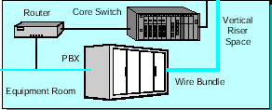
Figure 3-23: First Bank of Paradise Building Wiring
Router
Core Switch
Vertical
Riser
Space
PBX
25-Pair
Wire Bundle
Equipment Room
To Telephone
Company

Slide 66
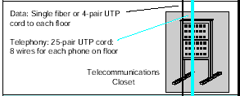
Figure 3-23: First Bank of Paradise Building Wiring , Continued
Data: Single fiber or 4-pair UTP
cord to workgroup switch
on each floor
Telephony: 25-pair UTP cord:
8 wires for each phone on floor
Telecommunications
Closet
Horizontal Telephone Wiring
Versus Vertical Data Wiring

Slide 67
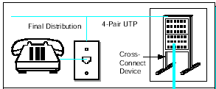
Figure 3-23: First Bank of Paradise Building Wiring , Continued
Office Building
Final Distribution
4-Pair UTP
RJ-45 Jack
Cross-
Connect
Device
Horizontal Telephone Wiring

Slide 68
Figure 3-23: First Bank of Paradise Building Wiring , Continued
Horizontal Distribution is Identical for voice and data
  One 4-pair UTP cord to each wall jack
  This is no accident; 4-pair UTP was developed for telephone wiring and data technologists learned how to use it for horizontal distribution
Vertical Distribution is Very Different for Voice and Data
  Telephone wiring: 8 wires for every wall jack on every floor
  Data wiring: a single UTP cord or fiber cord to each floor

Slide 69
Figure 3-23: First Bank of Paradise Building Wiring , Continued
Example
  25 Floors
  50 telephone jacks and 25 data jacks per floor
Vertical Telephone Wiring
  25 floors x 50 phone jacks/floor x 8 wires/jack
  10,000 wires must be routed vertically
  At least 200 25-pair UTP cords (phone wiring uses 25-pair cords)

Slide 70
Figure 3-23: First Bank of Paradise Building Wiring , Continued
Example
  25 Floors
  50 telephone jacks and 25 data jacks per floor
Vertical Data Wiring
  25 floors, so only 25 4-pair UTP cords (one to each floor’s workgroup switch)
  If all UTP, (200 wires) run vertically
  If fiber, only 25 fiber cords run vertically
  Can run UTP to some floors, fiber to others

Slide 71
Figure 3-23: First Bank of Paradise Building Wiring , Continued
Example
  25 Floors
  50 telephone jacks and 25 data jacks per floor
Horizontal Wiring
  One 4-pair UTP cord to each wall jack
  Same for voice and data
  50 phone jacks x 25 floors x 8 wires/cord = 10 k wires
  25 phone jacks x 25 floors x 8 wires/cord = 5 k wires

Slide 72
Figure 3-23: First Bank of Paradise Building Wiring , Continued
Building Telephone Wiring in Perspective
For Vertical Distribution, Voice and Data are Different
  Phone: 8 wires (4 pairs) for every phone wall jack on every floor. 25-pair UTP cords run vertically
  Data: one 4-pair UTP cord or one 2-strand fiber cord to each floor’s workgroup switch
For Horizontal Wiring, Voice and Data are the Same
  One 4-pair UTP cord to each wall jack on each floor

Slide 73
Topics Covered
Signaling
    Binary arithmetic
    Encoding alternatives with N bits
    On/Off versus voltage level signaling
    Binary versus digital

Slide 74
Topics Covered
UTP
  4-pair UTP cords and RJ-45 connectors and jacks
  Attenuation (measured in decibels) and noise
    Limit UTP cords to 100 meters
  Electromagnetic interference, crosstalk interference, and terminal crosstalk interference
    Limit wire unwinding to 1.25 cm (a half inch)
  Serial versus parallel transmission

Slide 75
Topics Covered
Optical Fiber
  On/off light pulses
  Core and cladding; perfect internal reflection
  Dominates for trunk lines among core switches
  2 strands/fiber cord for full-duplex transmission
  SC and ST connectors are the most common

Slide 76
Topics Covered
Optical Fiber
  Wavelength and wavelength division multiplexing
  Attenuation limits single-mode fiber cord length
  Modal bandwidth limits multimode fiber cord length
  Longer wavelength increases distance for both types

Slide 77
Topics Covered
Topologies
  Organization of devices and transmission links
  Point-to-point, star, hierarchy, ring, etc.
Building Data Wiring
  Vertical
    More complex for voice than for data
  Horizontal
    Identical for voice and data

